Slide 1
LEWICE STUDIO
RISK: LOW
Ice Accretion Analysis Report
Aircraft Icing Analysis
Airfoil: NACA 0012 | Chord: 0.914 m (36.00 in)
Date: April 21, 2026
Reference: 14 CFR Part 25 Appendix C | NASA LEWICE 3.2 | LEWICE Studio
LEWICE Studio | Aircraft Icing Analysis | April 21, 2026 | Confidential

Slide 2
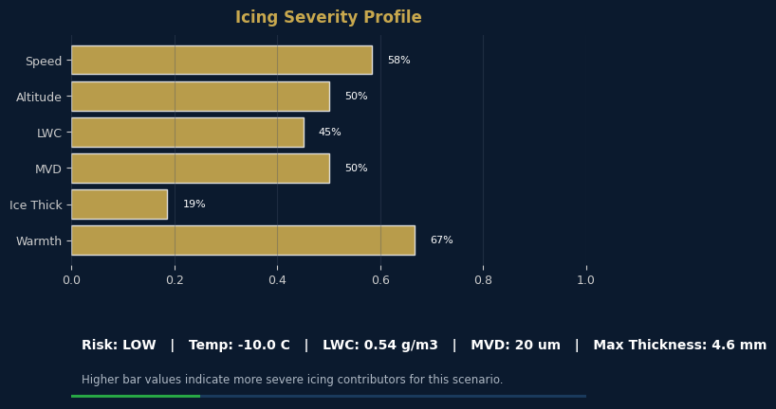
Icing Conditions Summary
Condition Dashboard
Parameter | Value | Unit
Freestream Velocity | 175.0 | KTAS
Altitude | 10000 | ft MSL
Static Temperature | -10.0 | deg C
Liquid Water Content | 0.54 | g/m^3
Median Volume Diameter | 20.0 | microns
Exposure Time | 6.0 | min
Angle of Attack | 0.0 | deg
Chord Length | 0.9144 / 36.00 | m / in
Ice Type (Predicted) | Mixed/Rime
Key Metrics
Max Ice Thickness
4.6 mm
Ice Type
Mixed/Rime
Risk Assessment
LEWICE Studio | Aircraft Icing Analysis | April 21, 2026 | Confidential
LOW

Slide 3
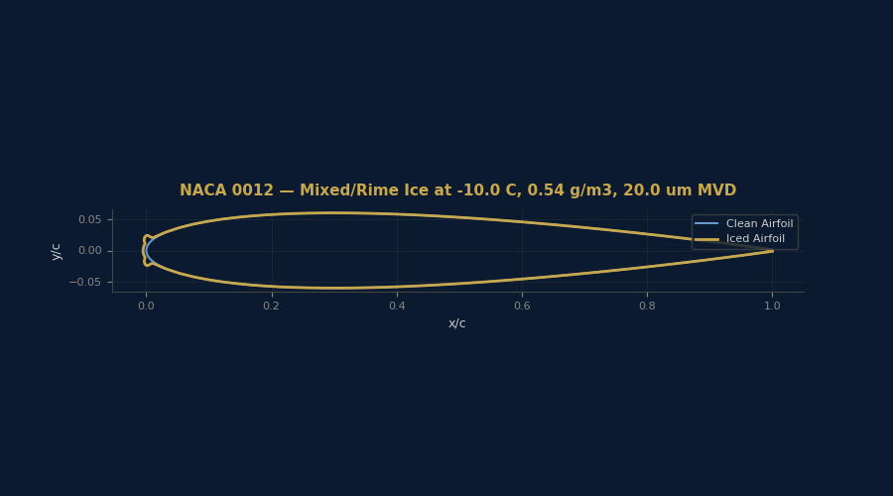
Ice Shape — Full Airfoil View
LEWICE Studio | Aircraft Icing Analysis | April 21, 2026 | Confidential

Slide 4
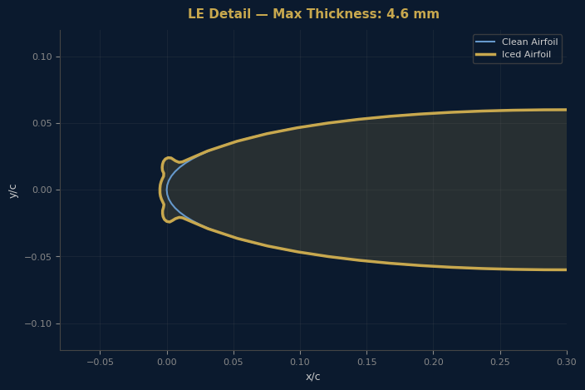
Ice Shape — Leading Edge Detail
LEWICE Studio | Aircraft Icing Analysis | April 21, 2026 | Confidential

Slide 5
Impingement Limits & Ice Metrics
Impingement data not available for this run.
Accretion Summary
Maximum ice thickness: 4.6 mm (0.183 in)
Ice type classification: Mixed/Rime
Risk assessment: LOW — Thin accretion, minimal aerodynamic impact expected.
Icing exposure: 6.0 min at 0.54 g/m3 LWC
Clean airfoil points: 159
Iced airfoil points: 119
LEWICE Studio | Aircraft Icing Analysis | April 21, 2026 | Confidential

Slide 6
Risk Assessment & Recommendations
LOW
MEDIUM
HIGH
Assessment: LOW
Thin accretion, minimal aerodynamic impact expected.
Recommendations
+ Ice accretion is within acceptable limits for continued flight operations.
+ Standard ice protection system activation procedures are sufficient.
+ No additional aerodynamic penalty analysis required for this condition.
+ Document results for certification file.
LEWICE Studio | Aircraft Icing Analysis | April 21, 2026 | Confidential

